Slide 1
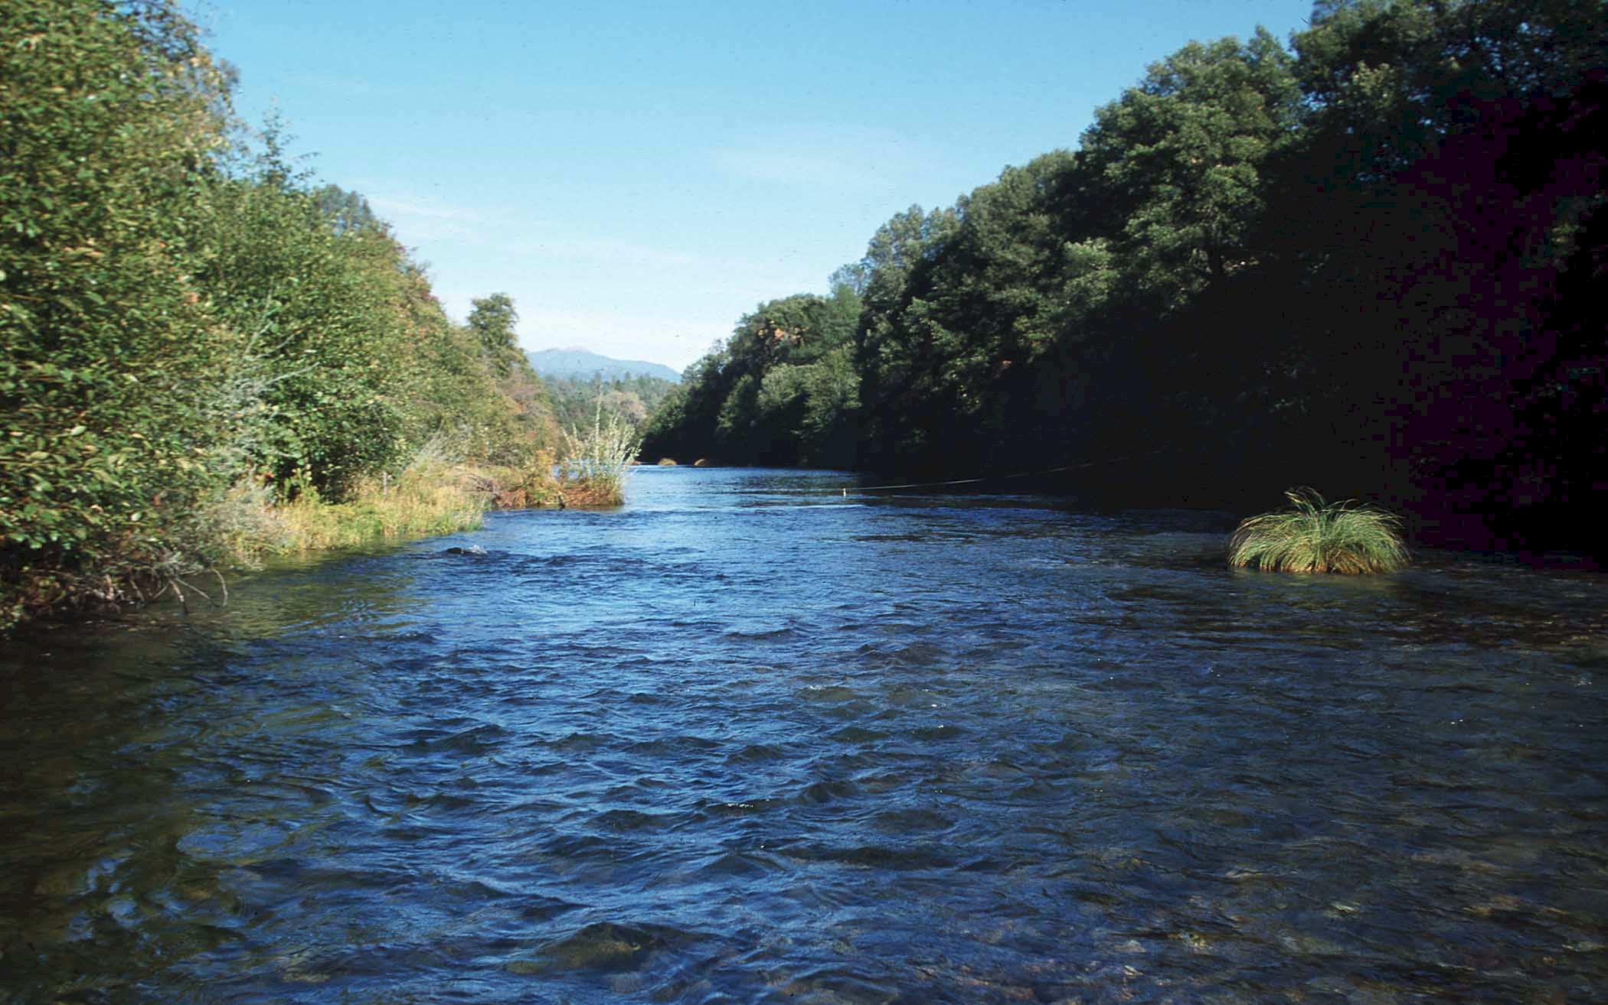
Open Channel Flow

Slide 2
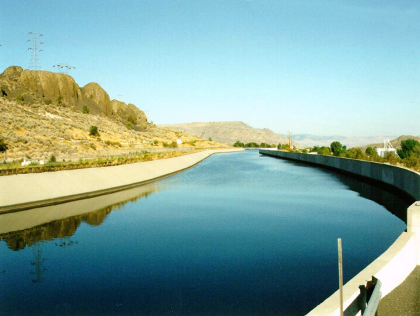
Open Channel Flow
Liquid (water) flow with a ____ ________ (interface between water and air)
relevant for
natural channels: rivers, streams
engineered channels: canals, sewer lines or culverts (partially full), storm drains
of interest to hydraulic engineers
location of free surface
velocity distribution
discharge - stage (______) relationships
optimal channel design
free surface
depth

Slide 3
Topics in Open Channel Flow
normal depth
Uniform Flow
Discharge-Depth relationships
Channel transitions
Control structures (sluice gates, weirs…)
Rapid changes in bottom elevation or cross section
Critical, Subcritical and Supercritical Flow
Hydraulic Jump
Gradually Varied Flow
Classification of flows
Surface profiles

Slide 4
Classification of Flows
Steady and Unsteady
Steady: velocity at a given point does not change with time
Uniform, Gradually Varied, and Rapidly Varied
Uniform: velocity at a given time does not change within a given length of a channel
Gradually varied: gradual changes in velocity with distance
Laminar and Turbulent
Laminar: flow appears to be as a movement of thin layers on top of each other
Turbulent: packets of liquid move in irregular paths
(Temporal)
(Spatial)

Slide 5
Momentum and Energy Equations
Conservation of Energy
“losses” due to conversion of turbulence to heat
useful when energy losses are known or small
____________
Must account for losses if applied over long distances
_______________________________________________
Conservation of Momentum
“losses” due to shear at the boundaries
useful when energy losses are unknown
____________
Contractions
We need an equation for losses
Expansion

Slide 6
Open Channel Flow: Discharge/Depth Relationship
Given a long channel of constant slope and cross section find the relationship between discharge and depth
Assume
Steady Uniform Flow - ___ _____________
prismatic channel (no change in _________ with distance)
Use Energy, Momentum, Empirical or Dimensional Analysis?
What controls depth given a discharge?
Why doesn’t the flow accelerate?
A
P
Compare with pipe flow
no acceleration
What does momentum give us?
geometry
What did energy equation give us?
What did dimensional analysis give us?
Force balance

Slide 7
Steady-Uniform Flow: Force Balance
τ_{o}P Δ x
Shear force =________
Energy grade line
P
Hydraulic grade line
Wetted perimeter = __
b
γA Δx sinθ
c
Gravitational force = ________
Δx
a
d
Shear force
W cos θ
θ
θ
Hydraulic radius
W
W sin θ
Turbulence
Relationship between shear and velocity? ___________

Slide 8
Open Conduits: Dimensional Analysis
Geometric parameters
___________________
___________________
___________________
Write the functional relationship
Does Fr affect shear? _________
Hydraulic radius (R_{h})
Channel length (l)
Roughness (ε)
No!

Slide 9
Pressure Coefficient for Open Channel Flow?
Pressure Coefficient
(Energy Loss Coefficient)
Head loss coefficient
Friction slope
Friction slope coefficient
Slope of EGL

Slide 10
Dimensional Analysis
Head loss ∝ length of channel
(like f in Darcy-Weisbach)

Slide 11
Chezy Equation (1768)
Introduced by the French engineer Antoine Chezy in 1768 while designing a canal for the water-supply system of Paris
compare
where C = Chezy coefficient
For a pipe
where 60 is for rough and 150 is for smooth
also a function of R (like f in Darcy-Weisbach)

Slide 12
Darcy-Weisbach Equation (1840)
f = Darcy-Weisbach friction factor
Similar to Colebrook
For rock-bedded streams
where d₈₄ = rock size larger than 84% of the rocks in a random sample

Slide 13
Manning Equation (1891)
Most popular in U.S. for open channels
(MKS units!)
Dimensions of n?
T /L^{1/3}
Is n only a function of roughness?
NO!
(English system)
Bottom slope
very sensitive to n

Slide 14
Values of Manning n
n = f(surface roughness, channel irregularity, stage...)
d in ft
d = median size of bed material
d in m

Slide 15
Trapezoidal Channel
Derive P = f(y) and A = f(y) for a trapezoidal channel
How would you obtain y = f(Q)?
1
y
z
b
Use Solver!

Slide 16
Flow in Round Conduits
radians
r
θ
A
y
Maximum discharge when y = ______
0.938d
T

Slide 17
Velocity Distribution
For channels wider than 10d
Von Kármán constant
0.8d
V = average velocity
d = channel depth
0.4d
0.2d
At what elevation does the velocity equal the average velocity?
V
0.368d

Slide 18
Open Channel Flow: Energy Relations
velocity head
energy
______ grade line
hydraulic
_______ grade line
Bottom slope (S_{o}) not necessarily equal to EGL slope (S_{f})

Slide 19
Energy Relationships
Pipe flow
z - measured from horizontal datum
From diagram on previous slide...
Turbulent flow (α ≅ 1)
y - depth of flow
Energy Equation for Open Channel Flow

Slide 20
Specific Energy
The sum of the depth of flow and the velocity head is the specific energy:
+ pressure
y - _______ energy
potential
- _______ energy
kinetic
If channel bottom is horizontal and no head loss
y
For a change in bottom elevation

Slide 21
Specific Energy
In a channel with constant discharge, Q
where A=f(y)
Consider rectangular channel (A = By) and Q = qB
q is the discharge per unit width of channel
y
A
3 roots (one is negative)
B
2
How many possible depths given a specific energy? _____

Slide 22
Specific Energy: Sluice Gate
sluice gate
q = 5.5 m²/s
y₂ = 0.45 m
V₂ = 12.2 m/s
EGL
1
E₂ = 8 m
vena contracta
2
Given downstream depth and discharge, find upstream depth.
alternate
y₁ and y₂ are ___________ depths (same specific energy)
Why not use momentum conservation to find y₁?

Slide 23
Specific Energy: Raise the Sluice Gate
sluice gate
EGL
1
2
as sluice gate is raised y₁ approaches y₂ and E is minimized: Maximum discharge for given energy.

Slide 24
Step Up with Subcritical Flow
Short, smooth step with rise Δy in channel
Given upstream depth and discharge find y₂
Energy conserved
Δy
Is alternate depth possible? __________________________
NO! Calculate depth along step.

Slide 25
Max Step Up
Short, smooth step with maximum rise Δy in channel
What happens if the step is increased further?___________
y₁ increases
Δy

Slide 26
Step Up with Supercritical flow
Short, smooth step with rise Δy in channel
Given upstream depth and discharge find y₂
Δy
What happened to the water depth?______________________________
Increased! Expansion! Energy Loss

Slide 27
Critical Flow
y_{c}
Find critical depth, y_{c}
Arbitrary cross-section
T
dy
A=f(y)
y
A
dA
P
T=surface width
More general definition of Fr
Hydraulic Depth

Slide 28
Flow in Round Conduits
radians
r
θ
A
y
Maximum discharge when y = ______
0.938d
T

Slide 29
radians
Critical flow
Solve for theta and get 1.958 rad

Slide 30
Solve Max Flow equation for D

Slide 31
Critical Flow: Rectangular channel
T
A_{c}
y_{c}
Only for rectangular channels!
Given the depth we can find the flow!

Slide 32
Critical Flow Relationships: Rectangular Channels
because
Froude number
inertial
force
gravity
force
velocity head =
0.5 (depth)

Slide 33
Max flow in a short horizontal channel ending in critical depth
Critical depth is 2/3 of the total energy of the flow
q is flow per unit width
The short channel assumption means we are ignoring major losses.
The assumption is that the velocity is zero (H=E) at the upstream end of the channel

Slide 34
Max flow in a short horizontal channel given constraint on surface elevation change
V is zero at upstream end
Bottom slope is zero
Include wall shear
H is upstream depth

Slide 35
Channel geometry given a target H/W ratio

Slide 36
Critical Depth
Minimum energy for a given q
Occurs when =___
When kinetic = potential! ________
Fr=1
Fr>1 = ______critical
Fr<1 = ______critical
0
Super
Sub

Slide 37
Critical Flow
Characteristics
Unstable surface
Series of standing waves
Occurrence
Broad crested weir (and other weirs)
Channel Controls (rapid changes in cross-section)
Over falls
Changes in channel slope from mild to steep
Used for flow measurements
___________________________________________
Difficult to measure depth
Unique relationship between depth and discharge

Slide 38
Broad-Crested Weir
y_{c}
E
H
y_{c}
P
Broad-crested
weir
Hard to measure y_{c}
E measured from top of weir
C_{d} corrects for using H rather than E.

Slide 39
Broad-crested Weir: Example
Calculate the flow and the depth upstream. The channel is 3 m wide. Is H approximately equal to E?
H
E
y_{c}
y_{c}=0.3 m
0.5
Broad-crested
weir
How do you find flow?____________________
Critical flow relation
Energy equation
How do you find H?______________________
Solution

Slide 40
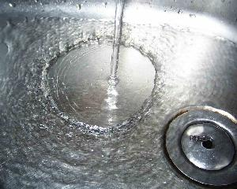
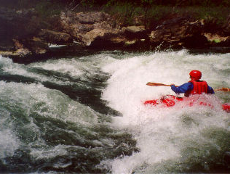
Hydraulic Jump
Could a hydraulic jump be laminar?
Used for energy dissipation
Occurs when flow transitions from supercritical to subcritical
base of spillway
Steep slope to mild slope
We would like to know depth of water downstream from jump as well as the location of the jump
Which equation, Energy or Momentum?

Slide 41
Hydraulic Jump
Conservation of Momentum
h_{L}
EGL
y₂
y₁
L

Slide 42
Hydraulic Jump: Conjugate Depths
For a rectangular channel make the following substitutions
Froude number
Much algebra
valid for slopes < 0.02

Slide 43
Hydraulic Jump: Energy Loss and Length
Energy Loss
algebra
significant energy loss (to turbulence) in jump
Length of jump
No general theoretical solution
Experiments show
for

Slide 44
Specific Momentum (M)
When is M minimum?
ΔE
Critical depth!

Slide 45
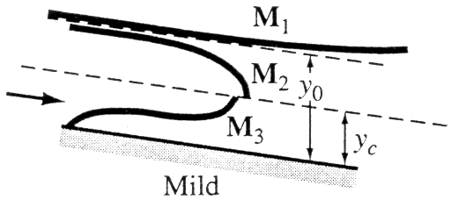
Hydraulic Jump Location
Suppose a sluice gate is located in a long channel with a mild slope. Where will the hydraulic jump be located?
Do you know either of the conjugate depths?
reservoir
Sluice gate
2 m
10 cm
Where are we going…
S = 0.005

Slide 46
Gradually Varied Flow: Find Change in Depth wrt x
Energy equation for non-uniform, steady flow
Shrink control volume
T
dy
y
A
P

Slide 47
Gradually Varied Flow: Derivative of KE wrt Depth
Change in KE
Change in PE
We are holding Q constant!
Is V ┴ A?
Does V=Q/A?_______________
If gradually varied!
The water surface slope is a function of:
bottom slope, friction slope, Froude number

Slide 48
Gradually Varied Flow: Governing equation
Governing equation for gradually varied flow
Gives change of water depth with distance along channel
Note
S_{o} and S_{f} are positive when sloping down in direction of flow
y is measured from channel bottom
dy/dx =0 means water depth is _______
constant
y_{n} is when

Slide 49
Surface Profiles
Mild slope (y_{n}>y_{c})
in a long channel subcritical flow will occur
Steep slope (y_{n}<y_{c})
in a long channel supercritical flow will occur
Critical slope (y_{n}=y_{c})
in a long channel unstable flow will occur
Horizontal slope (S_{o}=0)
y_{n} undefined
Adverse slope (S_{o}<0)
y_{n} undefined
Note: These slopes are f(Q)!

Slide 50
Surface Profiles
Normal depth
Obstruction
Sluice gate
y_{n}
Steep slope (S₂)
Steep slope
Hydraulic Jump
Negative if depth less than y_{n}
S₀ - S_{f} 1 - Fr² dy/dx
+ + +
y_{n}
y_{n}
- + -
y_{c}
- - +

Slide 51
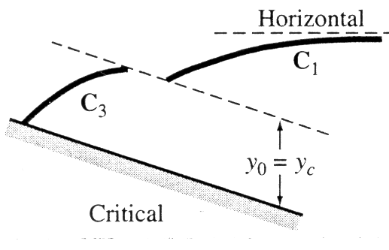
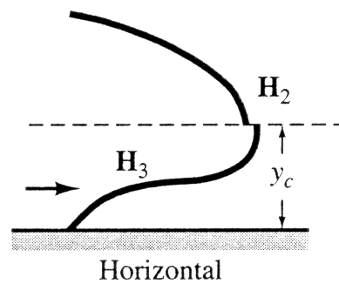
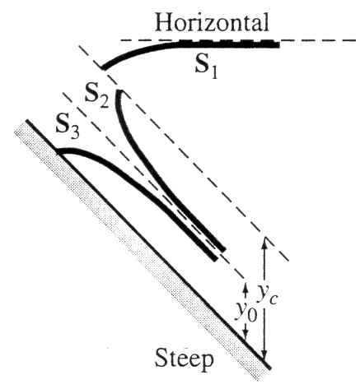
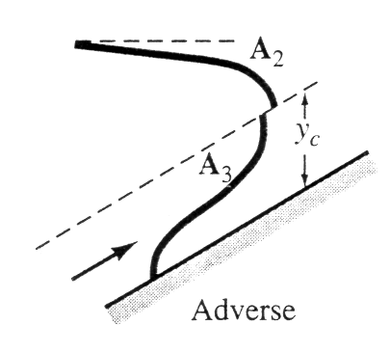
More Surface Profiles
S₀ - S_{f} 1 - Fr² dy/dx
1 + + +
2 + - -
y_{c}
y_{n}
y_{n}
3 - - +
y_{n}

Slide 52
Direct Step Method
energy equation
Given known section 1 and new depth (y₂), find distance to section 2
solve for Δx
What is S_{f}?
rectangular channel
prismatic channel

Slide 53
Start at upstream end. Try

Slide 56
Direct Step Method Friction Slope
Manning
Darcy-Weisbach
SI units
English units
Any other options for S_{f}?
Chezy!

Slide 57
Direct Step
prismatic
Limitation: channel must be _________ (channel geometry is independent of x so that velocity is a function of depth only and not a function of x)
Method
identify type of profile (determines whether Δy is + or -)
choose Δy and thus y_{i+1}
calculate hydraulic radius and velocity at y_{i} and y_{i+1}
calculate friction slope given y_{i} and y_{i+1}
calculate average friction slope
calculate Δx

Slide 58
Direct Step Method
=y*b+y^2*z
=2*y*(1+z^2)^0.5 +b
=A/P
=Q/A
=(n*V)^2/Rh^(4/3)
=y+(V^2)/(2*g)
=(G16-G15)/((F15+F16)/2-So)
A
B
C
D
E
F
G
H
I
J
K
L
M
y
A
P
Rh
V
Sf
E
Dx
x
T
Fr
bottom
surface
0.900
1.799
4.223
0.426
0.139
0.00004
0.901
0
3.799
0.065
0.000
0.900
0.870
1.687
4.089
0.412
0.148
0.00005
0.871
0.498
0.5
3.679
0.070
0.030
0.900

Slide 59
Standard Step
Given a depth at one location, determine the depth at a second given location
Step size (Δx) must be small enough so that changes in water depth aren’t very large. Otherwise estimates of the friction slope and the velocity head are inaccurate
Can solve in upstream or downstream direction
Usually solved upstream for subcritical
Usually solved downstream for supercritical
Find a depth that satisfies the energy equation

Slide 60
What curves are available? Steep Slope
S₁
S₃
y_{n}
Is there a curve between y_{c} and y_{n} that increases in depth in the downstream direction? ______
NO!

Slide 61
Mild Slope
If the slope is mild, the depth is less than the critical depth, what happens next?
Rapidly varied flow!
When dy/dx is large then V isn’t normal to cs
Hydraulic jump! Check conjugate depths

Slide 62
Water Surface Profiles: Putting It All Together
reservoir
Sluice gate
2 m
10 cm
S = 0.005
1 km downstream from gate there is a broad crested weir with P = 1 m. Draw the water surface profile.

Slide 63
Wave Celerity
V_{w}
y
y+δy
y
y+δy
V
V+δV
V-V_{w}
V+δV-V_{w}
unsteady flow
steady flow
Per unit width
F_{p1}
F_{p2}
V-V_{w}
V+δV-V_{w}

Slide 64
Wave Celerity: Momentum Conservation
Per unit width
Now equate pressure and momentum
y
y+δy
V-V_{w}
V+δV-V_{w}
steady flow

Slide 65
Wave Celerity
Mass conservation
y
y+δy
Momentum
V-V_{w}
V+δV-V_{w}
steady flow

Slide 66
Wave Propagation
Supercritical flow
c<V
waves only propagate downstream
water doesn’t “know” what is happening downstream
_________ control
Critical flow
c=V
Subcritical flow
c>V
waves propagate both upstream and downstream
upstream

Slide 67
Discharge Measurements
Sharp-Crested Weir
V-Notch Weir
Broad-Crested Weir
Sluice Gate
Explain the exponents of H!

Slide 68
Summary (1)
All the complications of pipe flow plus additional parameter... _________________
Various descriptions of energy loss
Chezy, Manning, Darcy-Weisbach
Importance of Froude Number
Fr>1 decrease in E gives increase in y
Fr<1 decrease in E gives decrease in y
Fr=1 standing waves (also min E given Q)
free surface location

Slide 69
Summary (2)
Methods of calculating location of free surface (Gradually varying)
Direct step (prismatic channel)
Standard step (iterative)
Differential equation
Rapidly varying
Hydraulic jump

Slide 70
Broad-crested Weir: Solution
E
y_{c}
y_{c}=0.3 m
0.5
Broad-crested
weir

Slide 71
Summary/Overview
Energy losses
Dimensional Analysis
Empirical

Slide 72
Energy Equation
Specific Energy
Two depths with same energy!
How do we know which depth is the right one?
Is the path to the new depth possible?

Slide 73
What next?
Water surface profiles
Rapidly varied flow
A way to move from supercritical to subcritical flow (Hydraulic Jump)
Gradually varied flow equations
Surface profiles
Direct step
Standard step

Slide 74
Hydraulic Jump!

Slide 75
Open Channel Reflections
Why isn’t Froude number important for describing the relationship between channel slope, discharge, and depth for uniform flow?
Under what conditions are the energy and hydraulic grade lines parallel in open channel flow?
Give two examples of how the specific energy could increase in the direction of flow.

Slide 76
Water Surface Profiles: Putting It All Together
y_{n}
reservoir
Sluice gate
M₁
2 m
M₃
y_{n}
E
10 cm
y_{c}
1
y_{c}=? m
1 km downstream from gate there is a broad crested weir with P = 1 m. Draw the water surface profile.

